Slide 1
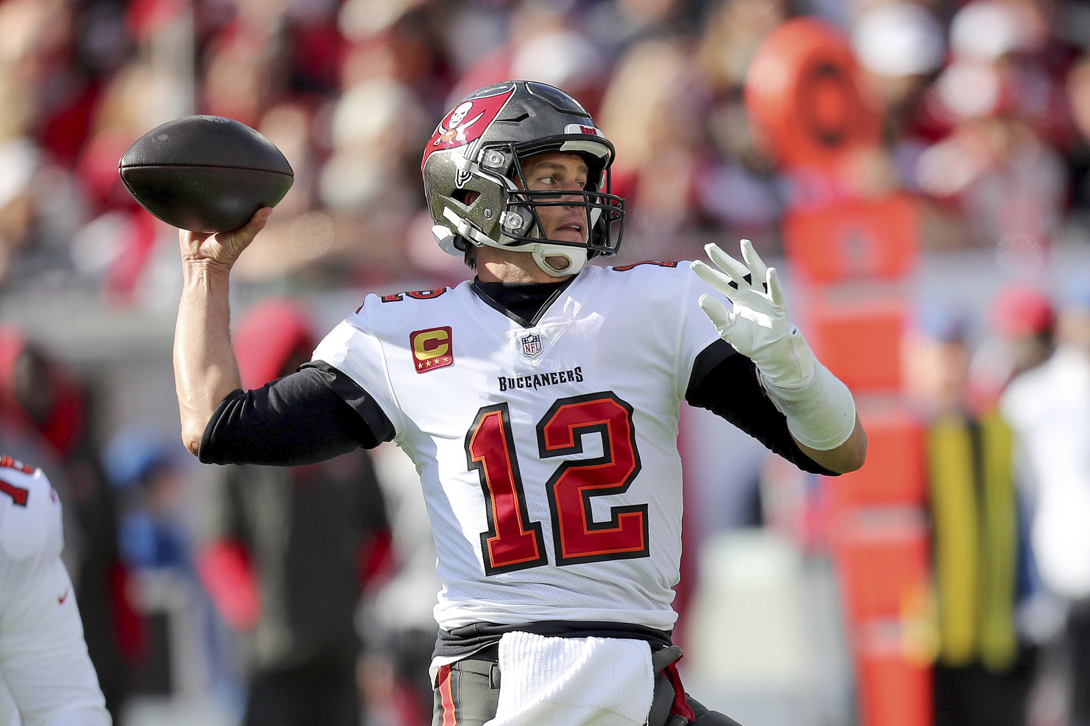
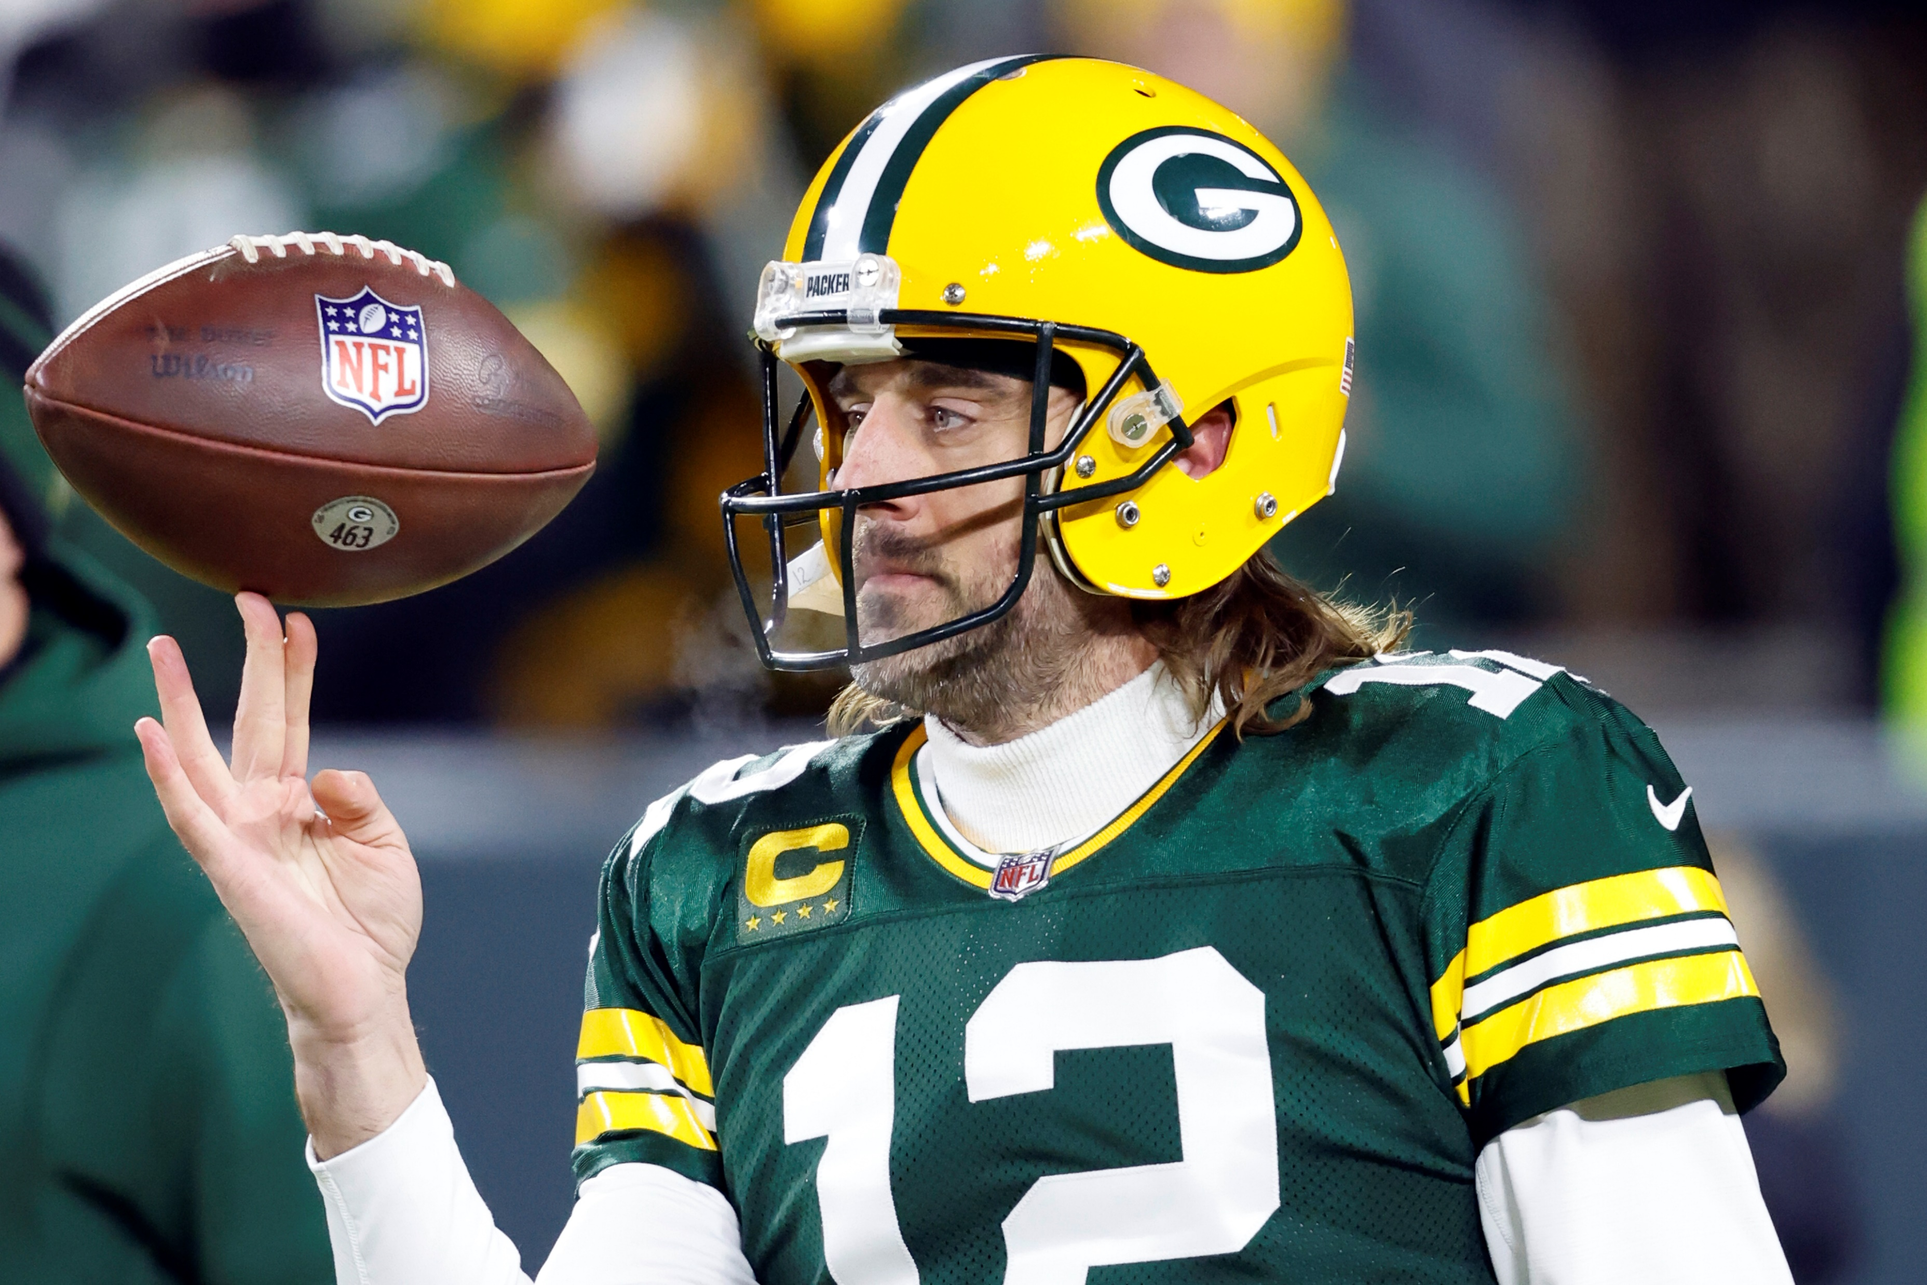
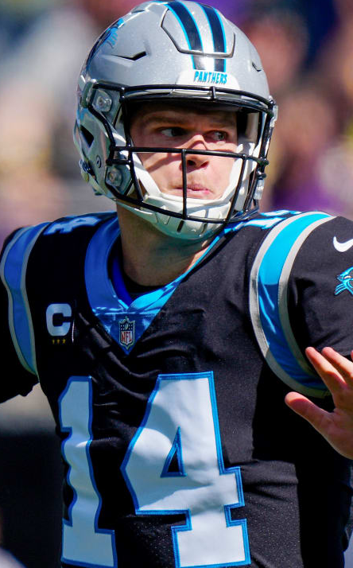
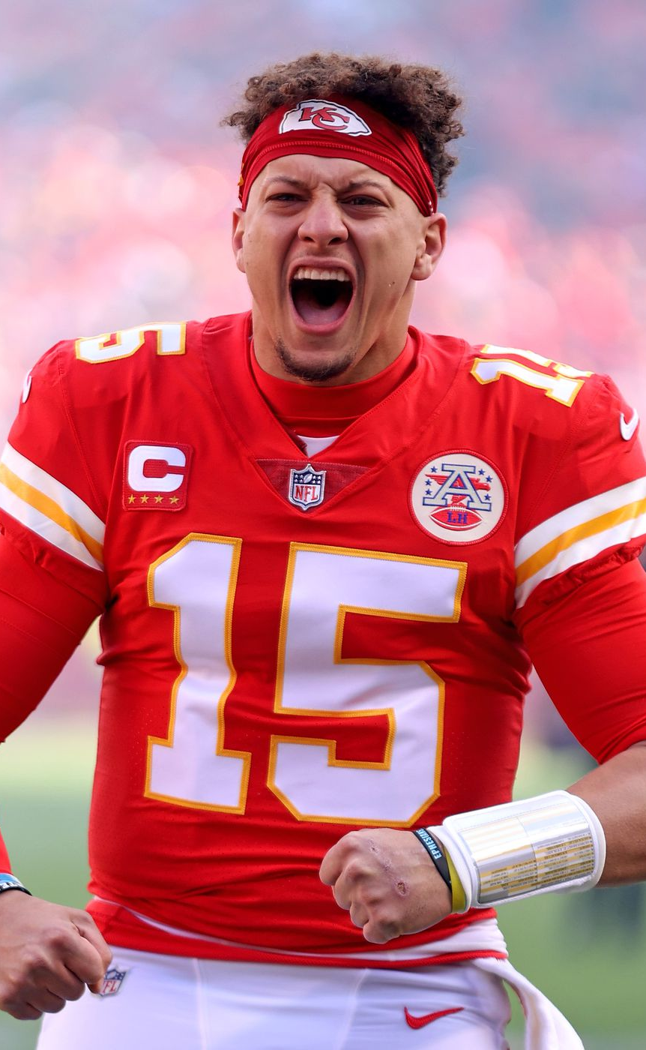
Who was the best NFL QB in 2021?
Jacob Segmiller

Slide 2
Process:
Wanted to look at this from an advanced analytics perspective without abandoning some of the more basic statistics.
To remove bias from the process, I outlined a process prior to looking at the data and followed it regardless of results.
Data from nflfastR
Graph 1: Plot EPA against CPOE and subset the data frame based on only the QB’s who were above average in both.
EPA: Expected Points Added per Play
CPOE: Completion % Above Expected
Graph 2: Plot passing yards against passing touchdowns and further subset the data frame for QB’s who were above average in both.
With the final subset of QB’s, I wanted to apply a formula that assigned a 0 to 1 score to determine which of them was the best. To do so I assigned each of them percentiles in certain statistics and created the formula as follows:
Weighted QB Play = (.25 * EPA Percentile) + (.25 * CPOE Percentile) + (.2 * WPA Percentile) + (.1 * Passing Yards Percentile) + (.1 * Passing TD’s Percentile) + (.1 * Completion % Percentile)

Slide 3
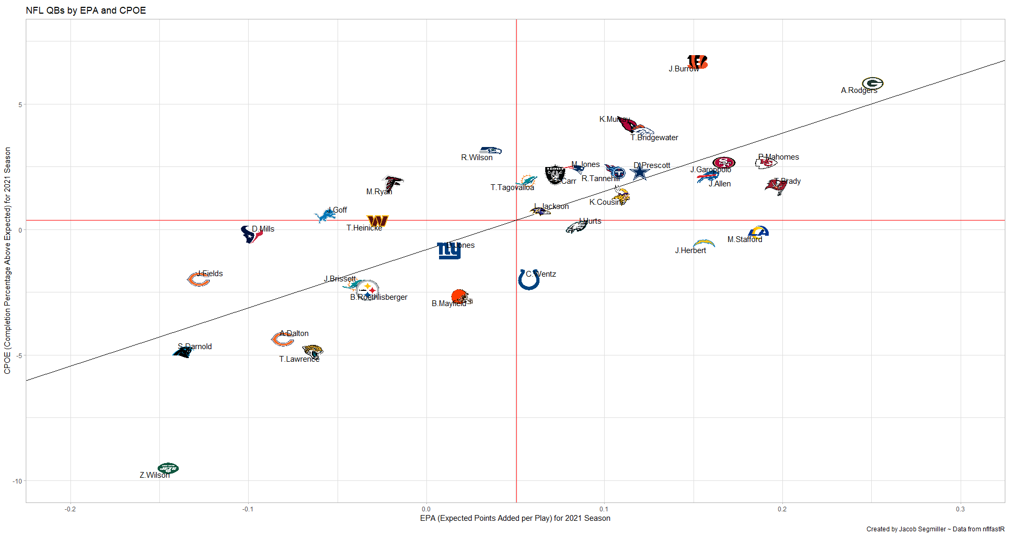
Graph 1: EPA and CPOE

Slide 4
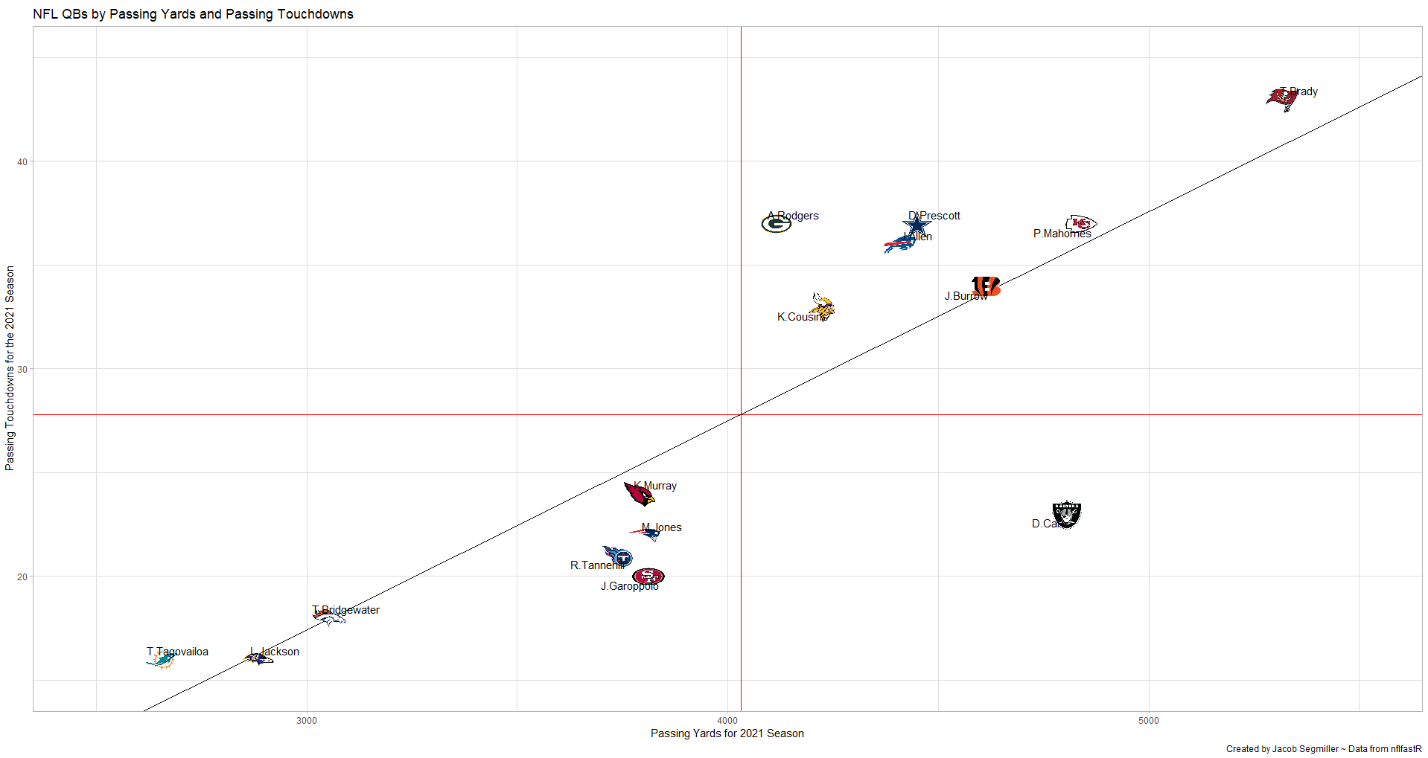
Graph 2: Passing Yards and TD’s

Slide 5
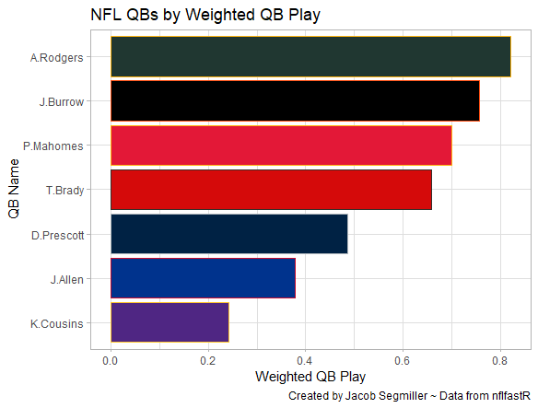

Weighted QB Play Calculation

Slide 6
Potential Changes to the Process
Should probably have found a way to factor in turnovers as well as rushing yards.
Since my goal was to remove bias, I followed the process I outlined prior to my analysis, but changes could have been made.
Looking back, I would have liked to have included Justin Herbert and Matthew Stafford.
Curious to see what sub-setting changed.

Slide 7
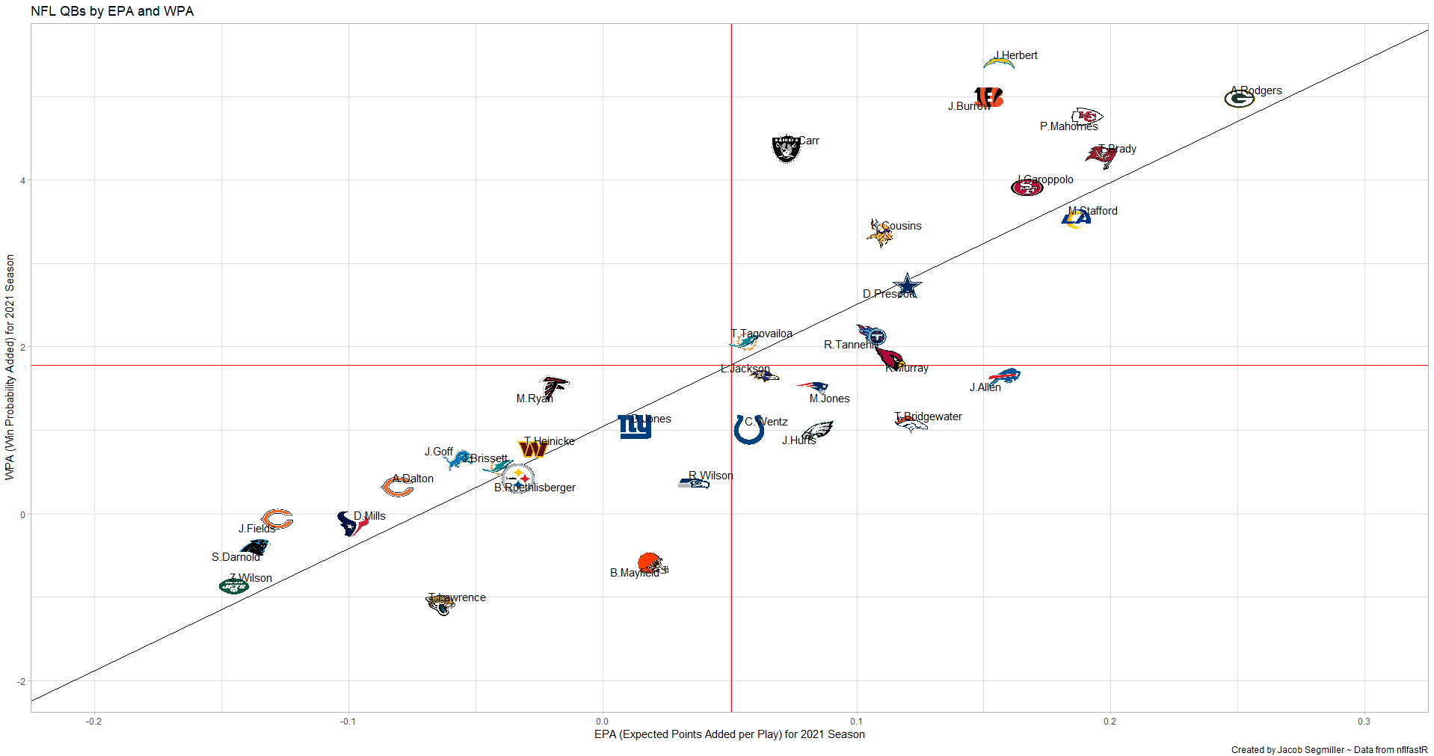
Supplemental Graph 1: EPA and WPA

Slide 8
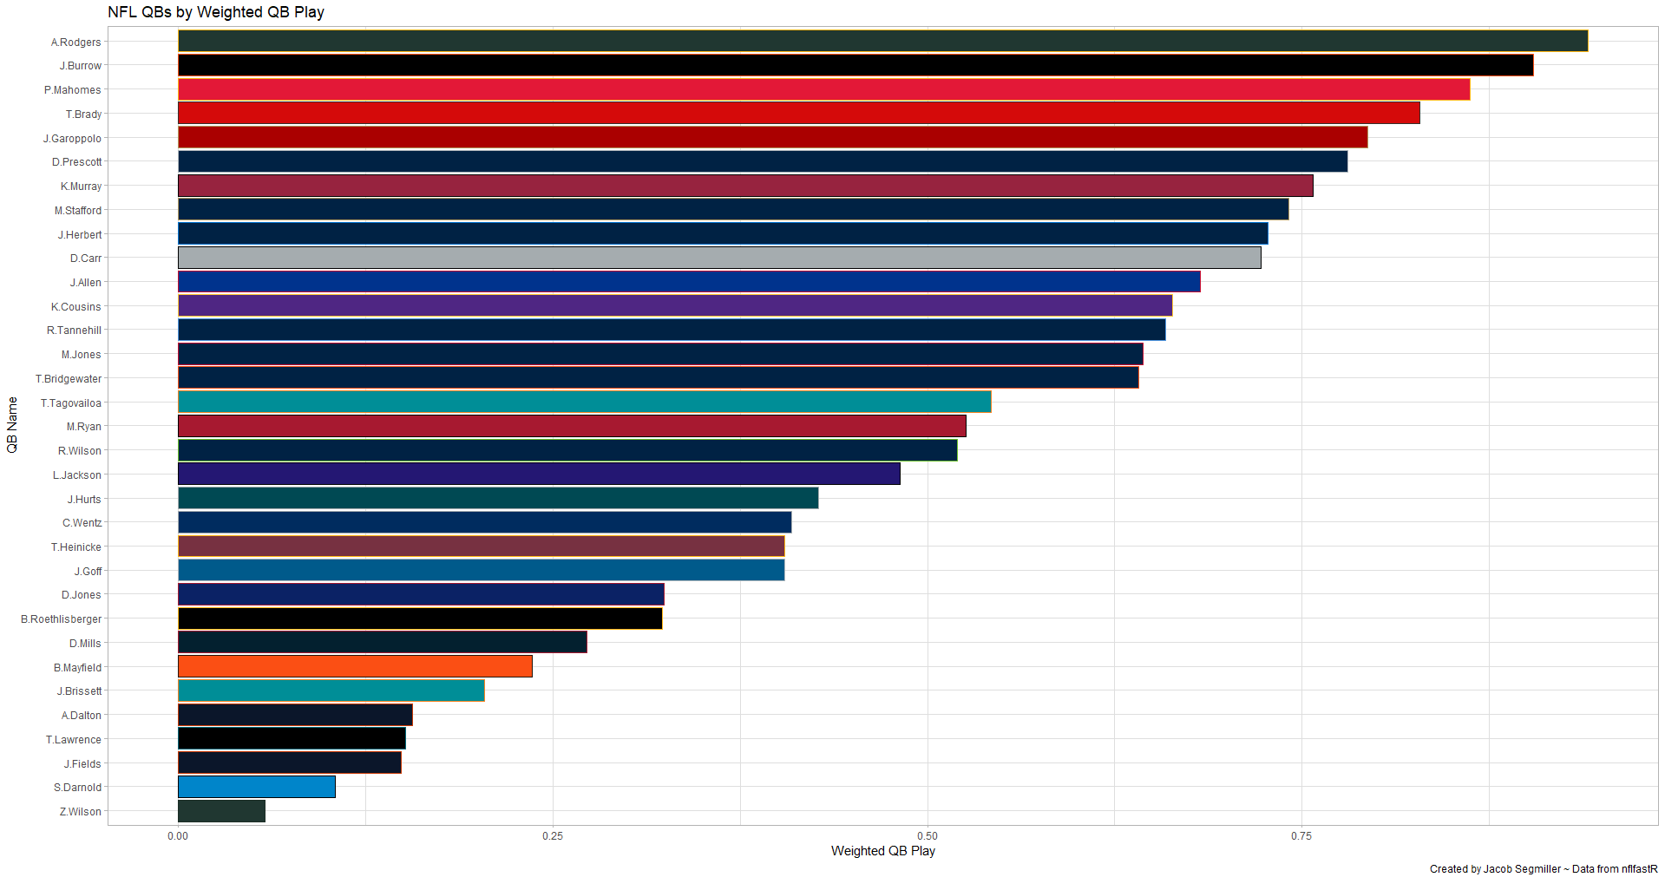
Supplemental Weighted QB Play Calculation

Slide 9
Final Observations
The process clearly has some merit to it, as reigning back-to-back NFL MVP was identified as QB1.
Subsetting may not affect the top tier QBs, however it can filter out the game managers.
Process should be refined to include other factors such as turnovers and rushing yards.

